Slide 1



fan
$$y+$$
$$F_{d}+F_{b}$$
ball
$$F_{g}$$
tube

Slide 2



$$y+$$
$$F_{d}+F_{b}$$
ball
$$F_{g}$$
tube
fan

Slide 3
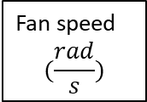



Desired position
$$(y_{in})$$
Fan speed
$$(\frac{rad}{s})$$
Air speed
($v_{f})$
System
Dynamics
controller
Sensor
$$(y, \dot{y})$$

Slide 4

Desired position
$$(y_{in})$$
controller
Fan
System
Dynamics
Output $(y, \dot{y})$

